Slide 1
Intermediate Progress Report
Food & Clothing Bank website
By: Group 38

Slide 2

Introduction
The Calgary Food and Clothing Bank is the first line of emergency food/clothing support for families and individuals facing crisis
Currently uses a manual system to receive and send out donations
Our group will develop a web application for the employees or volunteers to use, to increase the system’s efficiency.

Slide 3

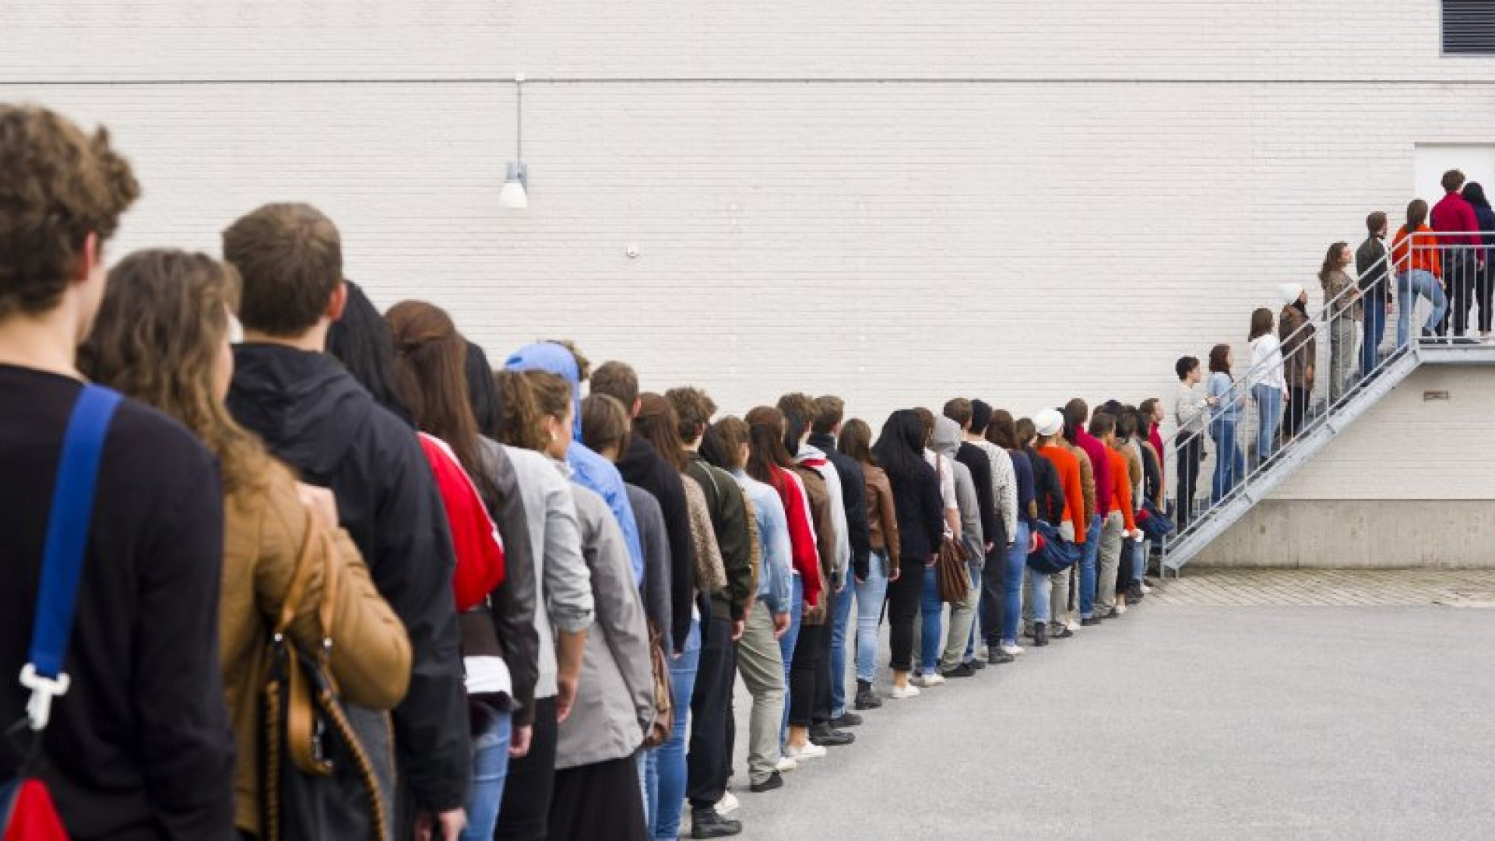
Problem Definition
Calgary Food/Clothing bank is currently doing it manually
Taking down information with pen and paper is tedious and time consuming
Prone to human error
Cause long wait times for clients

Slide 4

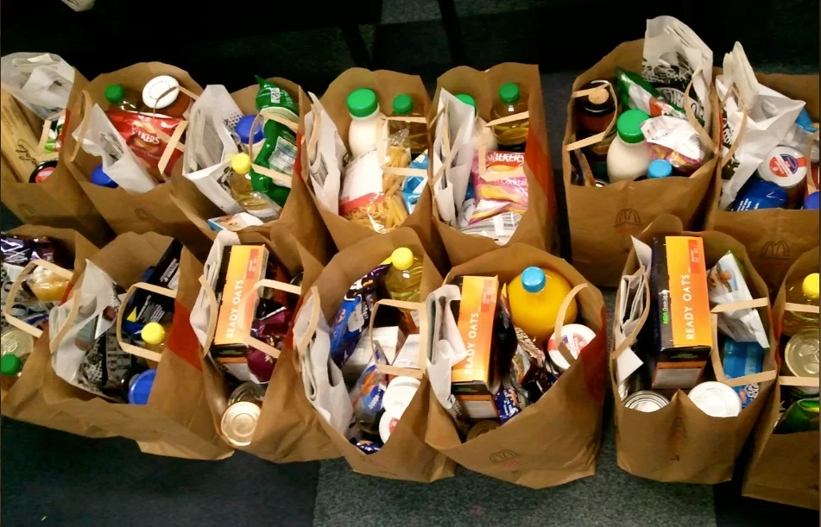
Proposed Solution
Increase the efficiency in bringing food and clothing to those in need
Reduce human error
Front employees verify clients then adds client into database
Front employees takes order where client can choose either a clothing section or food section depending on their needs, and will give list of either food or clothes to choose.
Back employees prepares the order
Clients then pick up their order

Slide 5
Things added to initial proposal
Implementation of clothing
Adds more entities
Adds more relationships

Slide 6
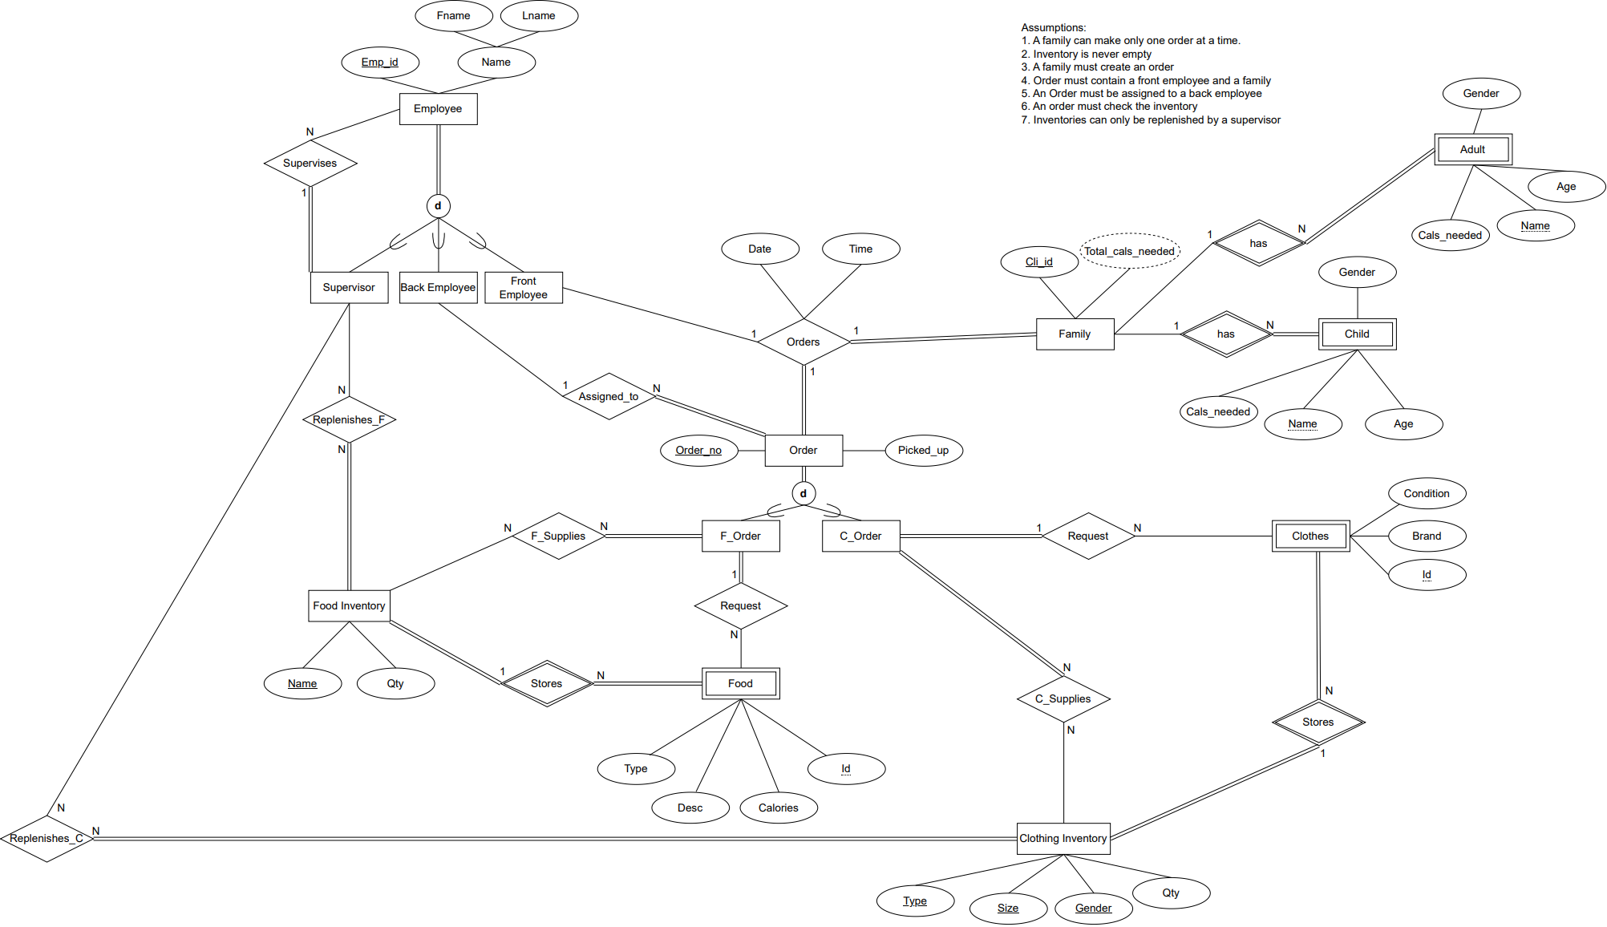

Slide 7
References:
https://www.unitedwaygt.org/issues/how-food-banks-in-canada-work-and-why-theyre-necessary/
https://www.calgaryfoodbank.com/volunteer/

Slide 8


Motivation
Efficient
Decrease the amount of human error
More families receive the food they need and faster
Help many families in need

Slide 9

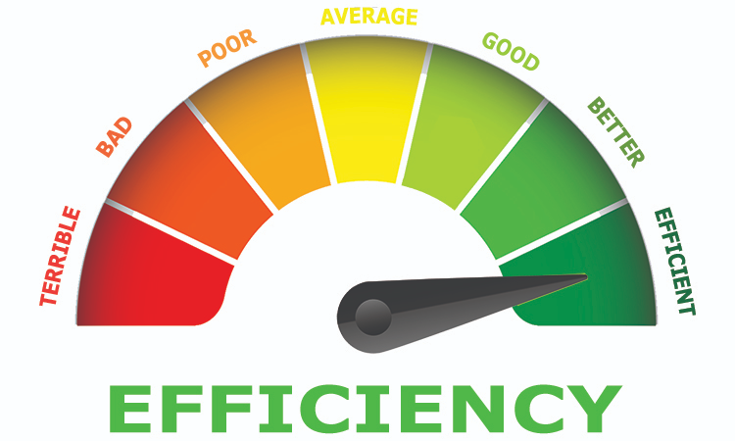
Conclusion
Create a web application to:
Decrease the amount of errors
Make the system faster
Decrease amount of inventory discrepancies
Decrease long wait times for clients

